Slide 1
Degree in Computing Year 3
Rich Web Applications
Lecture 3
XML / JSON
AJAX
http://www.w3schools.com/ajax

Slide 2

This Week
XML
What is it?
1st AJAX
Example
JSON
AJAX
How it works

Slide 3

What is XML??
XML stands for Extensible Markup Language.
New generation of documents that can
be transmitted over the Internet.
Based on SGML, as is HTML.
With HTML, all tags are pre-defined.
With XML, you create your own tags.

Slide 4



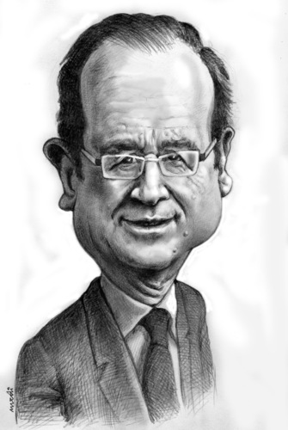


Translator
Notes:
Angela Merkel
Nicolas Sarkosy

Slide 5

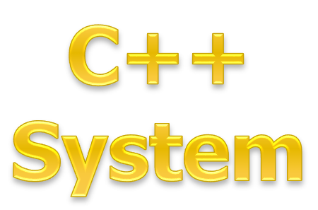
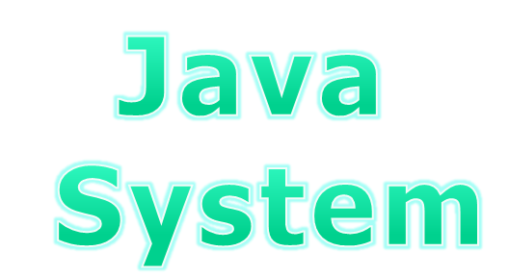


XML/JSON

Slide 6
XML
The aims for XML were:
  “...to establish a standard for commercial electronic data interchange that is open and accessible to all, and which delivers a broad spectrum of capabilities suitable to meet the full breadth of business needs.”
Ref: Guidelines for using XML for Electronic Data Interchange , Martin Bryan, The SGML Centre

Slide 7
Before XML
Traditionally data exchange between trading partners was done using EDI over a VAN.
  Expensive
  Inflexible
  Slow learning curve
  Excluded SME’s
Notes:
Talk about EDIFACT. Whats involved in EDI etc. Value Added Networks

Slide 8
XML versus traditional EDI
XML e-commerce solution
Requires web server costing £0 to £5000
Uses your existing Internet connection
XML message format learned in hours
Documents created using any programming language.
EDI e-commerce solution
Requires dedicated EDI server costing £10,000 to £100,000
Uses value-added network (VAN) charging £1 to £20 per message
EDI message format takes months to master
Requires highly trained programmers
Notes:
EDI is Electronic Data Interchange - Transfer of data such as invoices between different companies using networks.
EDI is has proven itself too complex and costly for small and many medium sized companies.
Compare XML to EDI to show how XML can now be used by all companies.

Slide 9
XML
XML was designed principally for the exchange of information in the form of computer documents over the Internet
Like HTML, XML is a subset of SGML
Unlike HTML where the tags are pre-defined, XML allows a document builder to define new tags within an XML document.

Slide 10
Advantages of XML Over EDI
  Low Cost
  Flexible
  Easy to learn
  Built in validation
  Additional Functionality
However since its conception in the late ’90s, XML has now been adopted as the standard for any persistent data that needs to be portable.

Slide 11
Uses of XML
Everyone talking about XML – What is it used for??
  Web Development
  Documentation
  Database Development
  Web Services
  AJAX
Notes:
http://webdesign.about.com/od/xml/a/aa060401a.htm
Web Develop,ment
In a way, you could argue that this is the most widespread use of XML, as XHTML.
you can create Web documents from XML using XSLT to transform your documents into HTML
Documentation
Many companies are moving to XML to write their internal documentation. The most common XML platform for this is DocBook. The advantage of XML for documentation is that it can be used to define the common traits in books, magazines, stories, advertisements, and so forth.
XML and Database Development
Databases are a natural use for XML, because XML is all about data.
The data is simply written in such a way to allow machines to read it and make it accessible to a database.

Slide 12
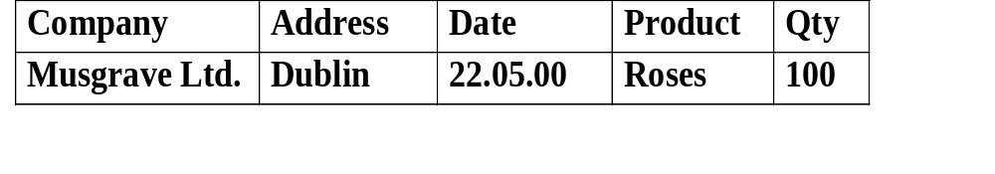
What does XML look Like?
Details stored in a database
XML document
<!DOCTYPE invoice SYSTEM invoice.dtd>
<invoice>
<date> 22nd May 2000 </date>
<company>
<name> Musgraves Ltd. </name>
<address> Dublin </address>
</company>
<order>
<product> Roses </ product >
<quantity> 100 </quantity>
</order>
</invoice>
Invoice
Notes:
Can store details in a database.
Can either create an XML document by typing it in or write a program to convert the details in the database to an XML document.
Go through tags.
The XML document is sent across the Internet.
Musgraves can view it via a browser or convert it to a word document.

Slide 13
A 2nd Example of XML
The following gives an example of a prescription done in XML.
      <?xml version="1.0"?>
      <prescription>
      <date> 14th May 1999 </date>
      <doctor>
      <name> Joe Bloggs </name>
      <address> Dublin 1 </address>
      </doctor>
      <medication>
      <product over_the_counter=“no”> Elicon </ product >
      <quantity> 250g </quantity>
      </medication>
      </prescription>
Root Element
Element
Nested Elements
Attribute
Content

Slide 14
Well formed XML
An XML document must be well-formed for the parser to process it correctly.
A parser is a program designed to check a document to make sure it obeys the rules.
Unlike HTML, XML is very strict in regards to how it is formed.
Here is a list of rules for a document to be well-formed:
Ref: XML Black Book – Natanya Pitts-Moultis and Cheryl Kirk

Slide 15
Well formed XML
The document must be surrounded by a single outermost root element or document.
Tags must be properly nested and all tags must have matching pairs.
All entities, elements, and attributes are case sensitive.

Slide 16



Slide 17
Exercise
Represent the following as an XML document:
Sales Order
Customer: ITB ref: 45221
Date: 1/1/2002
Products Qty Price
A4 paper 10 boxes €40
A3 paper 5 boxes €32

Slide 18
Write your answer here

Slide 19
XML Tutorials
W3schools.com
https://www.youtube.com/watch?v=Q0k5ySZGPBc

Slide 20
JAVASCRIPT OBJECT NOTATION
JSON

Slide 21
JSON
Two months ago you'd never heard of JSON
One month ago you'd heard the term but paid no attention
One week ago you'd heard it mentioned a few times and started to think, right... some more stuff to learn
Today you woke up with an alarm bell ringing in the back of your mind that said WHAT IS THIS JSON THING AND WHY IS IT EVERYWHERE ALL OF A SUDDEN!
Quote from: http://secretgeek.net/json_3mins.asp

Slide 22
JSON
What does it stand for?
  JavaScript Object Notation
And what does that mean?
  JSON is a syntax for passing around objects that contain name/value pairs, arrays and other objects.
  Was developed in 1999 as an alternative to XML
  Commonly used in AJAX applications

Slide 23
JSON
Here is an example of JSON
{"skillz":
{ "web":[
{"name": "html",
"years": "5" },
{"name": "css",
"years": "3" }],
"database":[
{"name": "sql",
"years": "7" }] }}

Slide 24
JSON
So you'd recognise some JSON if you saw it now?
Basically:
  Squiggles, Squares, Colons and Commas
    Squiggly brackets act as 'containers'
    Square brackets holds arrays
    Names and values are separated by a colon.
    Array elements are separated by commas

Slide 25
JSON vs XML
JSON is like XML because:
  They are both 'self-describing' meaning that values are named, and thus 'human readable'
  Both are hierarchical. (i.e. You can have values within values.)
  Both can be parsed and used by lots of programming languages
  Both can be passed around using AJAX (i.e. httpWebRequest)

Slide 26
JSON vs. XML
JSON is UNlike XML because:
  XML uses angle brackets, with a tag name at the start and end of an element: JSON uses squiggly brackets with the name only at the beginning of the element.
  JSON is less verbose so it's definitely quicker for humans to write, and probably quicker for us to read.
  JSON can be parsed trivially using the eval() procedure in JavaScript
  JSON includes arrays {where each element doesn't have a name of its own}
  In XML you can use any name you want for an element, in JSON you can't use reserved words from javascript

Slide 27
JSON vs. XML
But Why? What's good about it?
  When you're writing ajax stuff, if you use JSON, then you avoid hand-writing xml. This is quicker.
  Again, when you're writing ajax stuff, which looks easier?
  the XML approach or the JSON approach:

Slide 28
JSON vs. XML
The XML approach:
  bring back an XML document
  loop through it, extracting values from it
  do something with those values, etc,
versus
The JSON approach:
  bring back a JSON string.
  'eval' the JSON

Slide 29
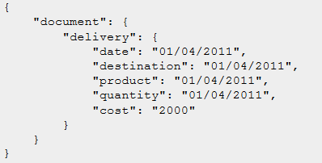
JSON vs XML
Here are some more JSON and XML examples
JSON

Slide 30
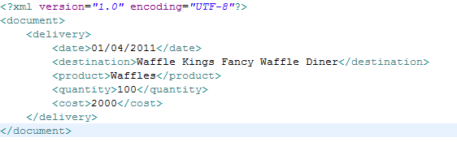
JSON vs. XML
XML Code

Slide 31
JSON vs. XML
JSON Code
{"messages":
{"message":[
{"id": "17",
"user": "Ryan Smith",
"text": "This is an example of JSON",
"time": "04:41"
},{"id": "18",
"user": "Ryan Smith",
"text": "Here is another Element",
"time": "04:41"
} ]}}
Notes:
{“Sales Order”:
{“Customer”: “ITB”,
“Ref:” : “45221”,
{“Product Details”:[
{“Product”: “A4 Paper”,
“QTY”: “10 Boxes”,
“Price”: “40”
},
{“Product”: “A5 Paper”,
“QTY”: “12 Boxes”,
“Price”: “40”
}]}}}

Slide 32
JSON vs. XML
XML Code
<?xml version="1.0" ?>
<root>
<message id="17">
<user>Ryan Smith</user>
<text>This is an example of JSON</text>
<time>04:41</time>
</message>
<message id="18">
<user>Ryan Smith</user>
<text>Here is another Element</text>
<time>04:41</time>
</message>
</root>

Slide 33

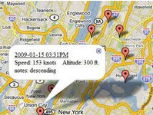



Who uses what?

Slide 34







Who uses what?

Slide 35
Conclusion
No Clear Winner
Choice depends on developers goals
JSON is a good choice for mobile development
XML is a good choice for large data

Slide 37
Exercise
From the previous exercise represent the following as a JSON document:
Sales Order
Customer: ITB ref: 45221
Date: 1/1/2002
Products Qty Price
A4 paper 10 boxes €40
A3 paper 5 boxes €32
Notes:
{“Sales Order”:
{“Customer”: “ITB”,
“Ref:” : “45221”,
{“Product Details”:[
{“Product”: “A4 Paper”,
“QTY”: “10 Boxes”,
“Price”: “40”
},
{“Product”: “A3 Paper”,
“QTY”: “5 Boxes”,
“Price”: “32”
}]}}}

Slide 38
Write your answer here

Slide 39
JSON Tutorials
W3schools.com
https://www.youtube.com/watch?v=BGfmpvM4Zp0

Slide 40
ASYNCHRONOUS JAVASCRIPT AND XML
AJAX

Slide 41
AJAX
Traditional Web Communication Process
Client/Server Side Technologies
What is AJAX
Common AJAX real-world examples

Slide 42
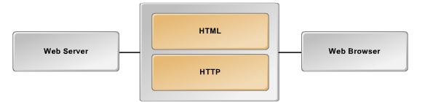
Traditional Web Communication Processes
Both HTML and HTTP work together to enable communication between the web server and the web browser.
This communication takes place over many stages:
Notes:
Taken from NH trainging on AJAX

Slide 43
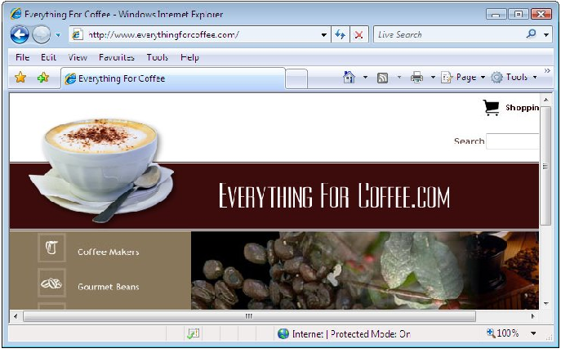
Traditional Web Communication Processes
Users initiate a communication either by entering a url or clicking a link

Slide 44

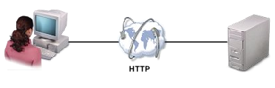

Traditional Web Communication Processes
Browser transmits the information to the web server using http.
Web server examines the url sent by the web browser and searches for page or file that was requested
When the server finds the requested item it sends it back to the browser.
The browser displays the requested file.

Slide 45
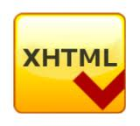

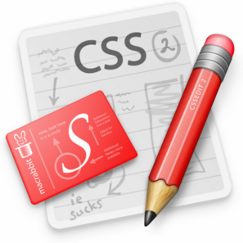

Client side Technologies
Client side technologies use programs that are run on the client machine by the browser

Slide 46


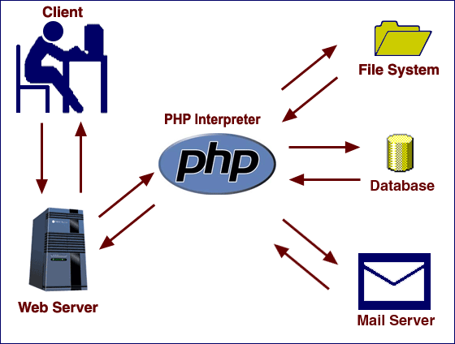
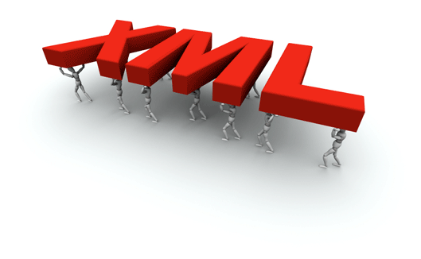
Server side Technologies
Server side technologies enable a server to interact with clients and process a request on behalf of the client

Slide 47
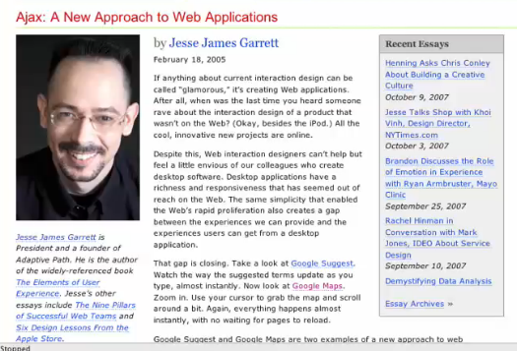
Who invented AJAX
A guy named Jesse James Garrett in early 2005 coined the term ‘AJAX’.
In early 2005 his consulting company was recommending this XMLHttpRequest to his clients
But He decided to use a shorter name - AJAX

Slide 48
So what is AJAX?
AJAX is not a programming language but a technique that enables JavaScript to communicate with the web server.
It will update ONLY THE REQUIRED DATA on the web page instead of refreshing the entire page
With traditional web pages users click a link to get information and wait for the page to be refreshed.

Slide 49
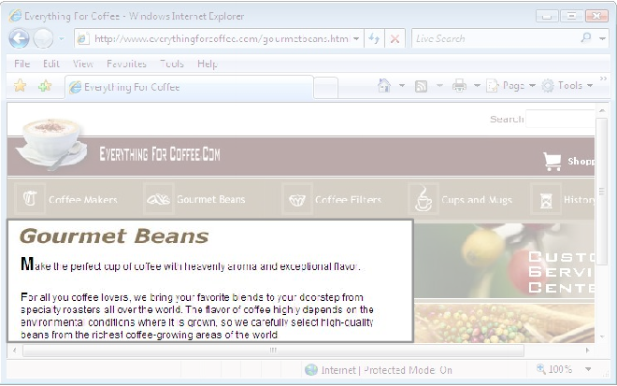
So what is AJAX?
But in web applications developed using AJAX only a part of the web page reloads
Users can view results immediately

Slide 50
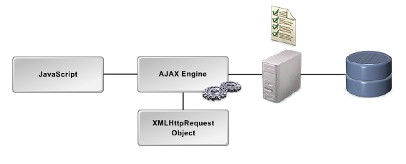
So what is AJAX?

Slide 51
So what is AJAX?
On the client side AJAX consists of JavaScript code that uses the AJAX engine to establish a connection to the server asynchronously.
The AJAX engine is a JavaScript object called the XMLHttpRequest(XHR) object.
This object is called whenever data needs to be retrieved from the server.
Server side scripts such as PHP or JSP then validate the information received from the client and may interact with a database before finally sending the response to the client.

Slide 52
So what is AJAX?
On the client side JavaScript process the response from the server.
It updates specific page elements.
Data is sent back from the server in one of several formats such as XML, HTML and JSON.

Slide 53
Some More Definitions
AJAX = Asynchronous JavaScript And XML
  A technique in Javascript to allow direct access to the server, allowing part of a page to be updated without a full page reload.
  The section of the page to be updated is identified using DOM & Xpath – i.e. the web page is handled as an XML document, with identifiable components.
AJAX is based on:
  JavaScript
  XML
  XHTML
  CSS
  Nothing new!!!
Prior to AJAX, the only way to send/receive data from the server was via the submit button on a HTML form.
This is a synchronous communication, the response could only be viewed once a new page was loaded.

Slide 54
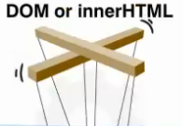
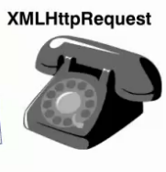
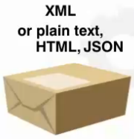
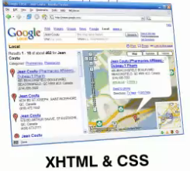

So what is AJAX? -Summary
AJAX is not a programming language but a combination of the following technologies

Slide 55
So what is AJAX? - Summary
JavaScript brings all of these technologies together:
  It monitors the users interaction with the page and determines if user makes a request.
  It creates and activates the XMLHttpRequest object to communicate with the server.
  It packages information to be sent/received from the server in XML or JSON format.
  It uses the DOM or innerHTML to modify the page currently displayed.

Slide 56
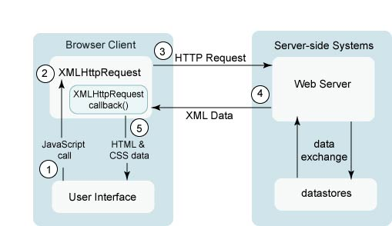
So what is AJAX? - Summary

Slide 57
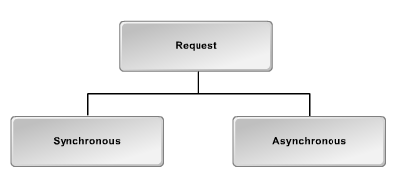
A Note on Web Server Requests
There are two types of requests that can be made to a web server.

Slide 58
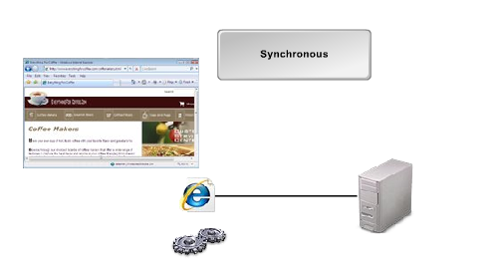

Web Server Requests
When a synchronous request is made to the server all process stop until the server responds with the update.
User is not allowed to work on the web page
while the response is been processed by the server

Slide 59
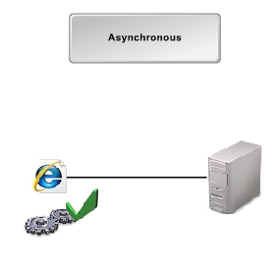
Web Server Requests
However when a request is made to the server asynchronously process can continue to run on the web browser, ie the user can make other requests on the browser.

Slide 60
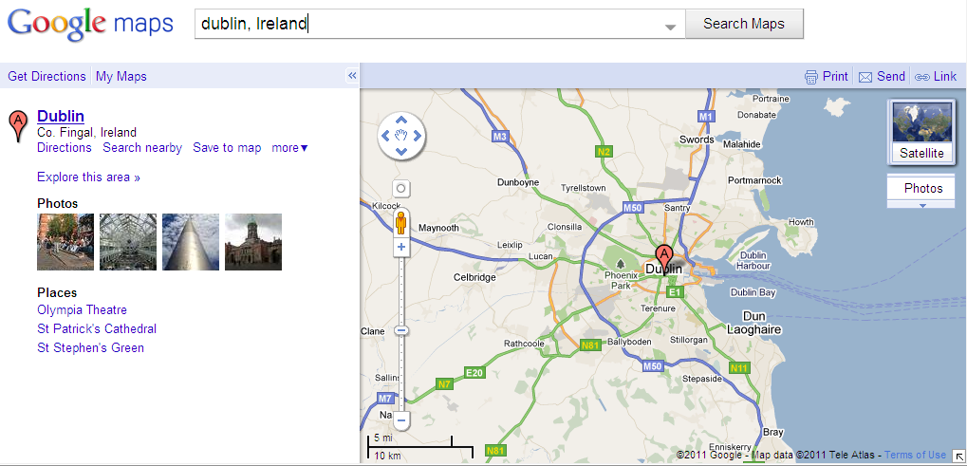
Examples of AJAX Applications
Most common one is Google Maps

Slide 61
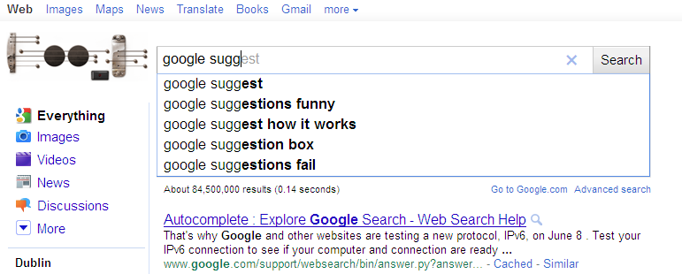
Examples of AJAX Applications
Google Suggest

Slide 62
Common examples
Google suggest (and amazon suggest)
  The user types in part of a keyword
  The javascript modules sends the partial keyword to the server, gets back a list of matches, and displayes them on screen,
Google maps
  An image is displayed of a specific region
  The user scrolls to a different region
  A new image is loaded an inserted into the current document

Slide 63
AJAX Explained
Good Tutorial explaining AJAX
  https://www.youtube.com/watch?v=tp3Gw-oWs2k
AJAX example
  https://www.youtube.com/watch?v=qqRiDlm-SnY

Slide 64

I am a blanket, sparkling on the ground
I am something always lost, never found
I am the beauty almost none can consume
I am the mirror of the full moon
What am I?

Slide 65

A Jewish women during the holocaust wants to cross the Swiss border in order to escape Nazi pursuers.
In order to cross the border, she must walk across a bridge.
The bridge takes 5 minutes to cross. However she has a problem. Every 3 minutes a guard emerges from the post to examine the bridge.
If He sees someone crossing from the Swiss side to the German side He sends them back.
If He sees someone crossing from the German side to the Swiss side He is to shoot them dead.
The women safely walks across the bridge

Slide 66
HOW AJAX WORKS
UNDERSTANDING THE XMLHTTP REQUEST (XHR) OBJECT
http://www.w3schools.com/php/php_ajax_intro.asp

Slide 67
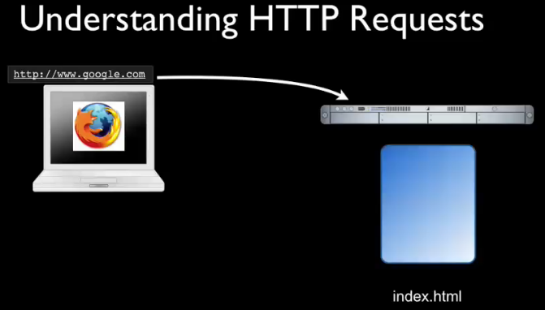
Notes:
In order to understand an XMLHttpRequest need to understand a HTTPRequest.
Want to load on google.com send message to web server saying I want that address.
Server grabs index page and sends it back to the browser.
Browser starts to render that page and finds a tag with a reference to an image so browser now needs to get this image from the server so that’s an other HTTP Request.
The server looks for the image sends image to browser which finishes rendering page and displays it to the screen.
Rendering is a process by which a web browser interprets HTML markup (along with CSS and anything else that might change the appearance or layout of the web page) and determines the position and appearance of each element.
://wiki.answers.com/Q/What_does_render_mean_in_HTML#ixzz26zKXYazQ

Slide 68
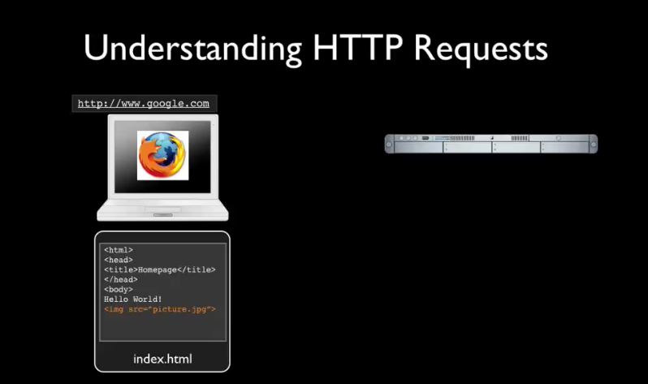

Slide 69
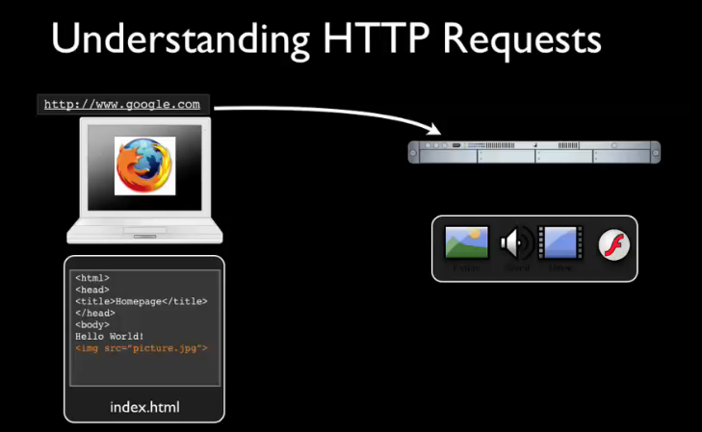

Slide 70
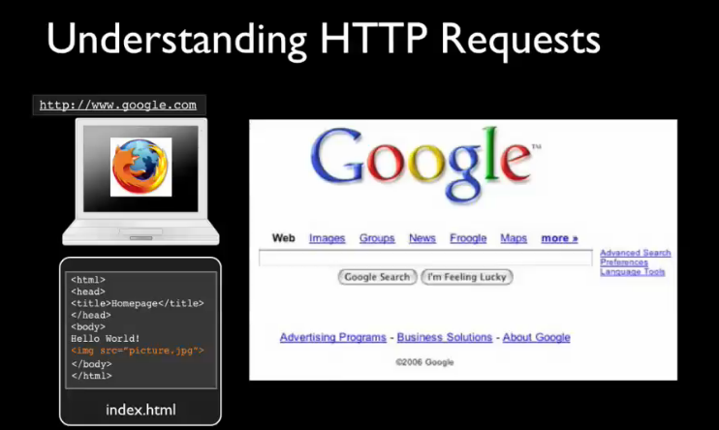

Slide 71
XMLHttpRequest object
AJAX works via the XMLHttpRequest(XHR) object
  This is a DOM API that can be used inside a browser script to send a HTTP or HTTPS request directly to the server, and load the response data directly back into the scripting language.
  The response can be processed as plain text, or as an XML or JSON document.
XMLHttpRequest has a number of properties and methods used to implement AJAX:

Slide 72
XMLHttpRequest properties
readyState – current status of request
onreadystatechange –stores the function to be executed when the server responds to the request
responseText –stores the text returned from server
responseXML – DOM model of returned text
status – HTTP status code indicating error if request failed (200 - ok, 404, 500 etc.)
statusText – text associated with HTTP status above

Slide 73
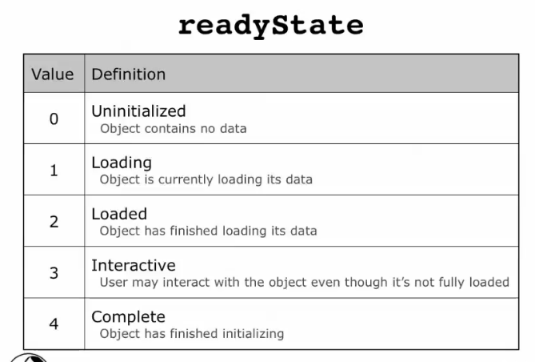
XMLHttpRequest Properties

Slide 74
XMLHttpRequest methods
open(method, url [, async [, user, password]]) – define the method to be called, and how it is to be called.
send(params) – send the request above, along with POST method parameters, (or null if using GET)
setRequestHeader(<name>, <value>) – set header values
getResponseHeader(<headerName>)
abort() – stop the current request
G. Gray © 2009

Slide 75
Our First AJAX Example
In this example we will read an xml file using AJAX and display it as a text file to the browser
Note:
For security reasons, with IE7+ the xml file needs to stored on a server.
We can use usbwebserver to do this.
Store the file in the root folder on usbwebserver and call the file from here.
Notes:
AJAX Essential Training
CHAPT3 , S4

Slide 76
Our First AJAX Example
script.html
<html>
<head>
<title>The Simplest Ajax Script</title>
<script src="script.js" type="text/javascript">
</script>
</head>
<body>
<div id="updateArea">&nbsp;</div>
</body>
</html>

Slide 77
Our First AJAX Example
script.js
window.onload = makeRequest;
var xhr = false;
function makeRequest() {
if (window.XMLHttpRequest) {
// code for IE7+, Firefox, Chrome, Opera, Safari
xhr = new XMLHttpRequest();
}
else {
if (window.ActiveXObject) {
// code for IE6, IE5
try {
xhr = new activeXObject("Microsoft.XMLHTTP");
}
catch (e) { }
}}

Slide 78
Our First AJAX Example
script.js (contd.)
// if xhr contains a value
if (xhr) {
// if there is a change of state calls function showContents
// it opens the file first and then sends the request and then
// calls showContents
xhr.onreadystatechange = showContents;
// Uses the GET command to get the colors.xml file, true is // for asynchronous
xhr.open("GET", "http://localhost/ajax/colors.xml", true);
// Sends the request
xhr.send(null);
}
else {
// put an error message into the body with id "updateArea" // on HTML document
document.getElementById("updateArea").innerHTML = "Sorry, but I couldn't create an XMLHttpRequest";
}
}
Notes:
The onreadystatechange is called if there is a change of state by the server.
So in essence it firstly opens the xml file sends the request to the server , when the state changes it then calls the function showContents

Slide 79
Our First AJAX Example
script.js (contd.)
function showContents() {
// if readystate = 4 => complete
if (xhr.readyState == 4) {
// if status = 200 => ok
if (xhr.status == 200) {
// get the response, ie xml file
var outMsg = xhr.responseText;
}
else {
var outMsg = "There was a problem with the request " + xhr.status;
}
// display the xml details in the "updateArea"
document.getElementById("updateArea").innerHTML = outMsg;
}
}

Slide 80
onreadystatechange property of XMLHttpRequest
The onreadystatechange property stores the function that will process the response from a server. The function is stored in the property to be called automatically.
The following code sets the onreadystatechange property and stores an empty function inside it:
xmlhttp.onreadystatechange=function()
{
// code to process the response
}

Slide 81
readystate property of XMLHttpRequest
The readyState property holds the status of the server's response.
  Each time the readyState property changes, the onreadystatechange function will be executed.
Possible values for the readyState property:
State | Description
0 | The request is not initialized
1 | The request has been set up
2 | The request has been sent
3 | The request is in process
4 | The request is complete

Slide 82
responseText property of XMLHTTPRequest
The data sent back from a server can be retrieved with the responseText property.
For example, if the server is sending back the current time, the responseText will hold that value:
xmlhttp.onreadystatechange=function()
{
if(xmlhttp.readyState==4)
{
document.getElementById("updateArea").innerHTML =xhr.responseText;
}
}
XPath expression identifying where in the HTML page the response should be placed
Data from server

Slide 83
open() and send() methods
The final step is to send the request to the server.
The request is constructed using the open() method which can take up to five parameters:
  Method: Get, Post, Head, Put etc.
  URL of server side script
  If the request should be asynchronous (optional, default=true)
  4&5. You can also provide a username and password with the request - optional
  Example: xmlhttp.open("GET",“colors.xml",true);
The send() method sends the request off to the server
  xmlhttp.open("GET",“colors.xml",true);
  xmlhttp.send(null);

Slide 84
Use of Get or POST
GET is simpler and faster than POST, and can be used in most cases.
However, always use POST requests when:
  A cached file is not an option (update a file or database on the server)
  Sending a large amount of data to the server (POST has no size limitations)
  Sending user input (which can contain unknown characters), POST is more robust and secure than GET

Slide 85
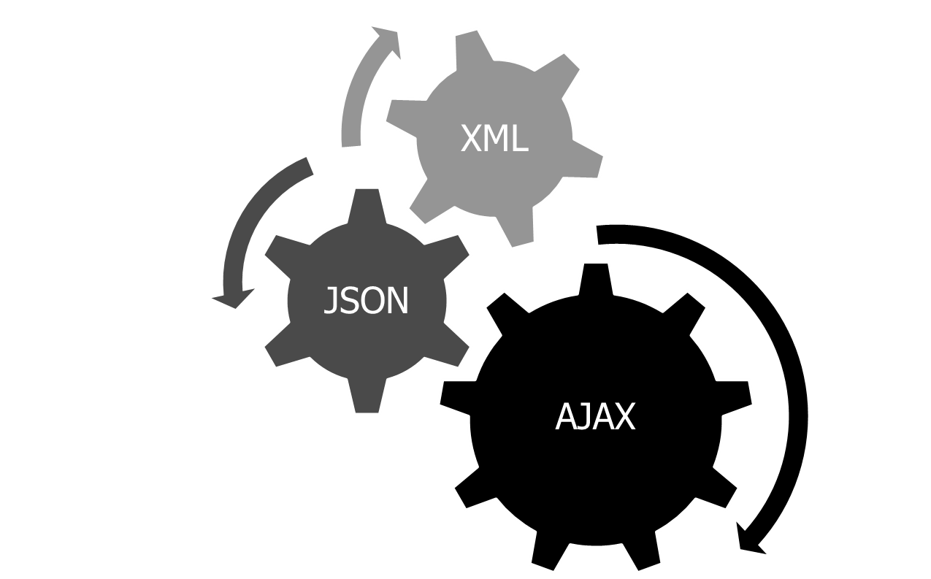

Summary

